Slide 1
Core Flight System to Trick Variable Server Interface
Colin Lewis
Summer 2017

Slide 2

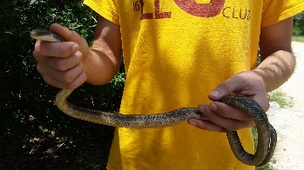
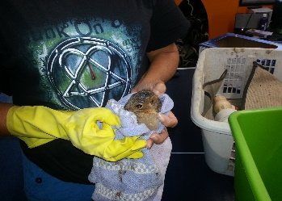



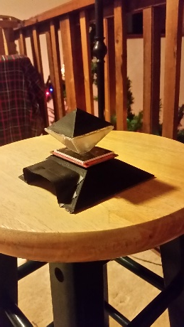
Biographical
Wimberley, Texas
UIL Academics
Science Camp
Animal Sanctuary
University of Texas at Austin
Honors Computational Engineering
Sigma Gamma Tau Honor Society
Texas Aerial Robotics
Student Engineering Council
Peer Advisor
Hobbies and Interests
Traveling
Bouldering
Prototyping

Slide 3
Project Introduction
To create a generalized application within Core Flight System (CFS) which can communicate with a Trick simulation through the Trick variable Server (TVS).
Demand:
Provide the capability to read and write to a Trick simulation
From a controlling application in CFS without breaking
the wrapper on the sim.
Objectives:
Needs to be general
Needs to be portable
Needs to Preserve the “wrapper”
Needs to “Keep up” with real time Sims
Realization:
Use the publicly available wheelbot sim by John Penn as a test bed
for my application.
CFS
TVS IO
TVS
Trick

Slide 4
Procedure: Trick Development
TVSIO 1.0
Core Infrastructure established
Primary functionality in Jobs:
VarServInit
-creates & configures connection to variable server.
VarServRun
-Reads information from variable server & stores data into structures useable by the rest of the application.
VarServWrite
-Writes data from the application to the variable server of the other sim.
Compile Wheelbot
Configuring computer, compiling Trick
Split Sim Object
Separate Control and Dynamic models and jobs
Objects communicate through reference
“Breaking the Wrapper” on wheelbot
Split Simulation
Create two distinct, communicating Trick Sims
First iteration of TVSIO, in the form of jobs in the Control Sim.
Final update of dynamics SIM.
Wheelbot_fsw
Wheelbot
Wheelbot_Control
Wheelbot_Dyn
Wheelbot_dyn

Slide 5
Procedure: C and CFS
Leaving Trick
Convert Control from C++ to C
Introduction to Makefiles
First frequency based obstacles
The Core Flight System
Tutorial introduction
Back to Scheduled jobs
Application Based Structure
Ongoing Work
Table Based Configuration
HTML Output
TVSIO 2.0
Beyond Trick
C
-TVSIO becomes a library called by control C application
CFS
-Converted to application which gains CFS internal read/write and scheduling capabilities.
Wheelbot_fsw
Wheelbot_control
CFS
Wheelbot_dyn
Wheelbot_dyn
Wheelbot_dyn

Slide 6

Impact
Technical Skills:
Trick
CFS
Makefiles
Object oriented C++
Casting
Troubleshooting
Performance-minded code
Going Forward:
Trick to the masses (of UT computational students)
More efficient coding as I move to larger projects
Application:
TVSIO can be deployed in HiTL tests running CFS to rapidly substitute simulated subsystems for hardware to more quickly evaluate different configurations.

Slide 7
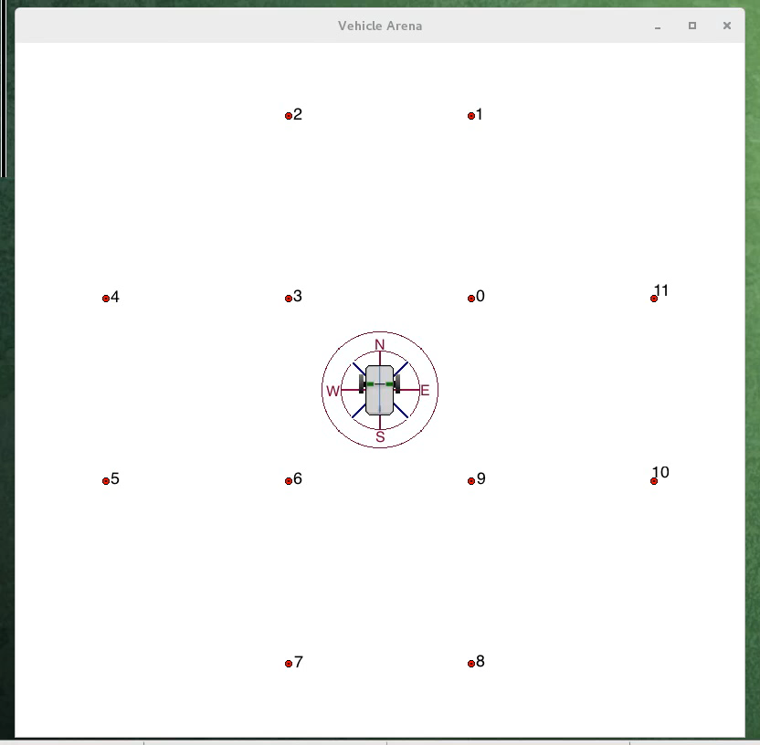
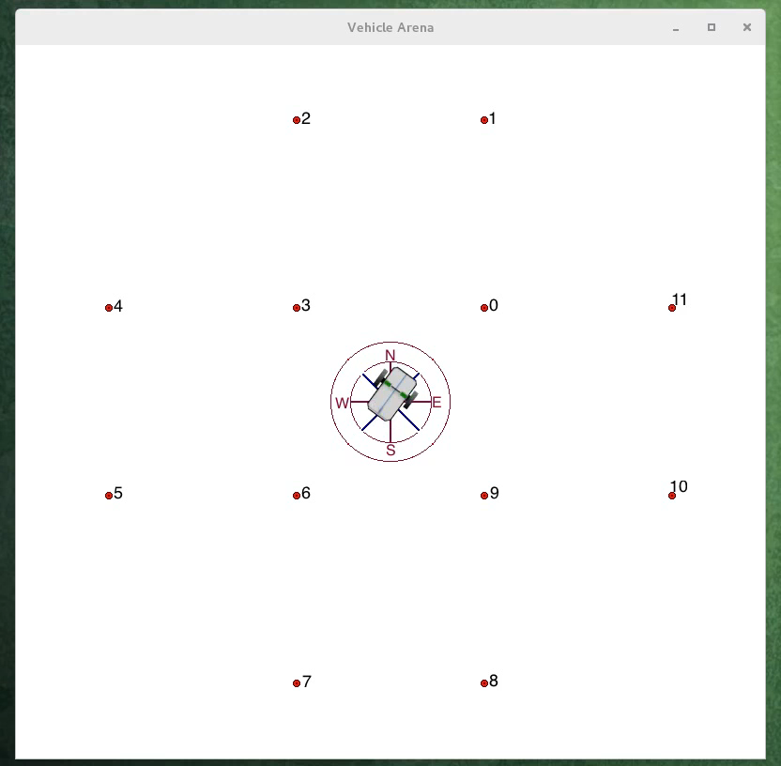
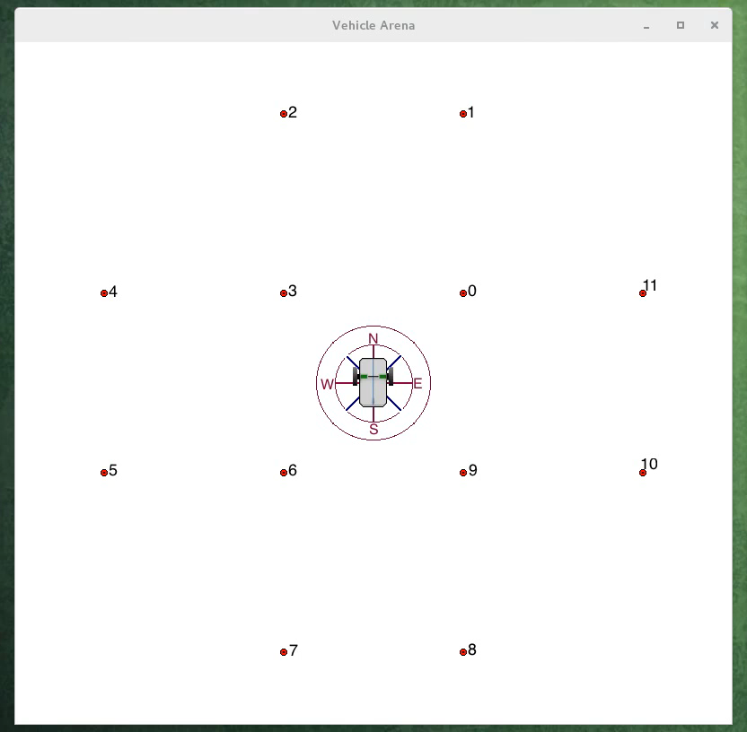
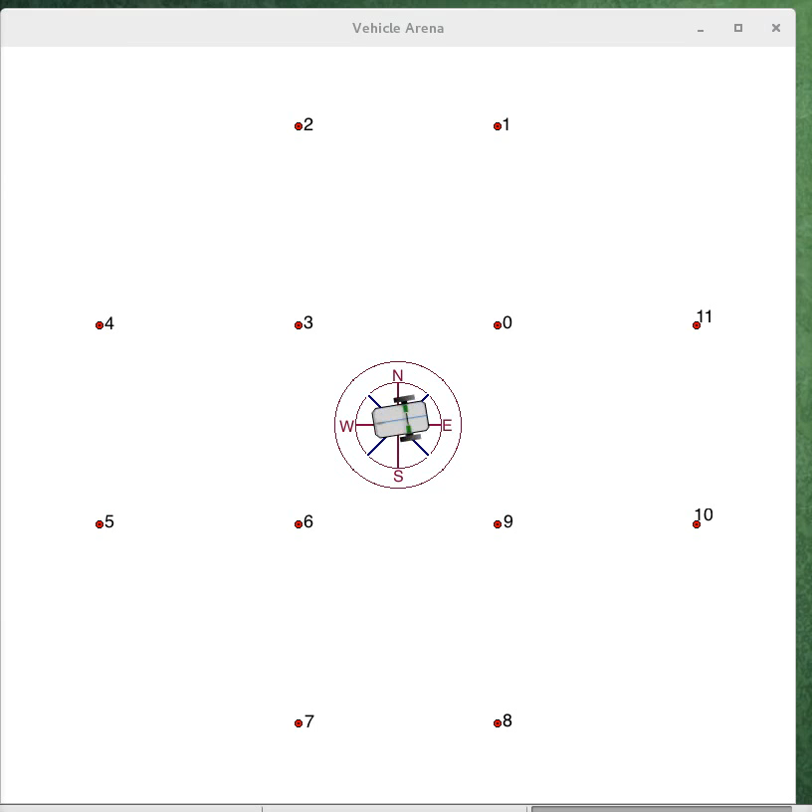
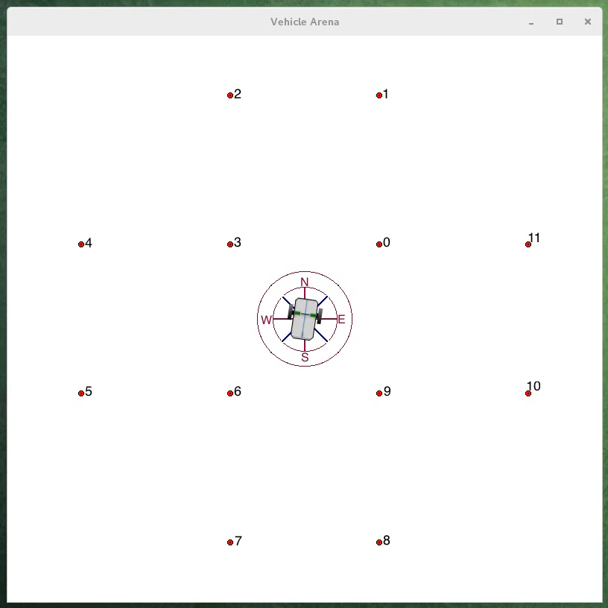
Lessons Learned: The Evidence

Slide 8

Conclusion
Special Thank you to:
Zu Qun Li, mentor
Zack Crues, mentor
Mike Red, recruitment
Alex Lin, Trick support
Derek Bankieris, Variable Server support
John Penn, Wheelbot support
Danrae Pray, CFS support
Spencer Riner, Linux support
Judy Kimball, keeping me on track
And the Rest of ER7 for your support
Holly Middaugh, internship team
Courtney Barringer, internship team
Melissa Corning, internship team

